Slide 1
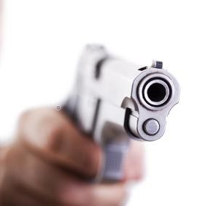
Active Shooter prepared readiness December 3, 2022 Brother Tito Koonce Brother Steven Durant
Notes:
2 Hour Presentation Intro Yourself
Can we go over every scenario you may face with an active shooter in 2 hours?
Can’t do that in 2 hours, 2 weeks, or 2 month.
Every situation will be different, but what I am going to do today is plant a seed in your head.
If you water that seed and nourish it…
---NO GUARANTEES

Slide 2
Active Attack Events
A.D.D. / Run, Hide, Fight
Notes:
Let’s take a look at some of the research into active shooter events.

Slide 3
What is an Active Shooter?
An individual actively engaged in killing or attempting to kill people in a confined and populated area.

Slide 4
Why we are here…
Notes:
Violence Disclaimer
Hypercacher Kosher Supermarket siege, Paris, France 2015
The question is not when, but where will the next attack be? We are here to begin to harden our citizens through knowledge, this is knowledge we as first responders have gained through the loss of our citizens as well as our own lives. It would be a disservice to those that have given their lives not to learn from these incidents, but more importantly take those lessons learned and share them. By disseminating these lessons we empower our citizens and prepare them to save not only their life, but possibly those around them as well, because WE are our brothers keeper!

Slide 5
Active Shootings 2000 – 2020
400+ Events
-3100 Casualties
1120+ Killed
1960+ Wounded

Slide 6
Top Country For Active Shooter Incidents
#1 US = -3100 incidents
#2 Canada = 8 incidents

Slide 7
Active Shooter Profile
Correct a perceived = Anger, revenge, ideology untreated mental illness
No concern - Safety or threat / Capture / victims – Intended or Unintended
Usually, will not attempt to open locked or barricaded doors
Stopped by law enforcement, suicide or intervention by victims

Slide 8
SEE * SAY* D0 SOMETHING
73% of active shooters had a connection with the attack site
88% age 17 or younger targeted their school or a former school
21% researched previous attacks by others

Slide 9
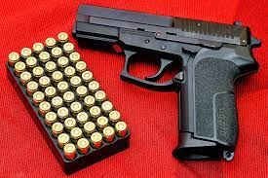
Between 2000 – 2020 there were 345 active Shooter Events
WEAPONS USED
310 Handguns
162 Long Guns:
109 Rifles
53 Shotguns
34% Long Guns
66% Handguns

Slide 10
SHOOTER OUTCOMES
45% Apprehended by LE
55% Suicide
20% Law enforcement
6% Citizens
2% At Large

Slide 11
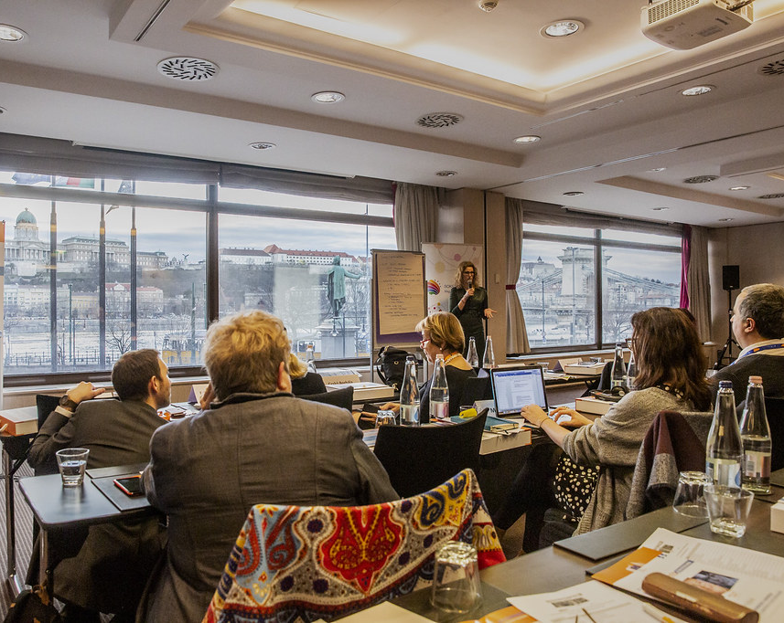
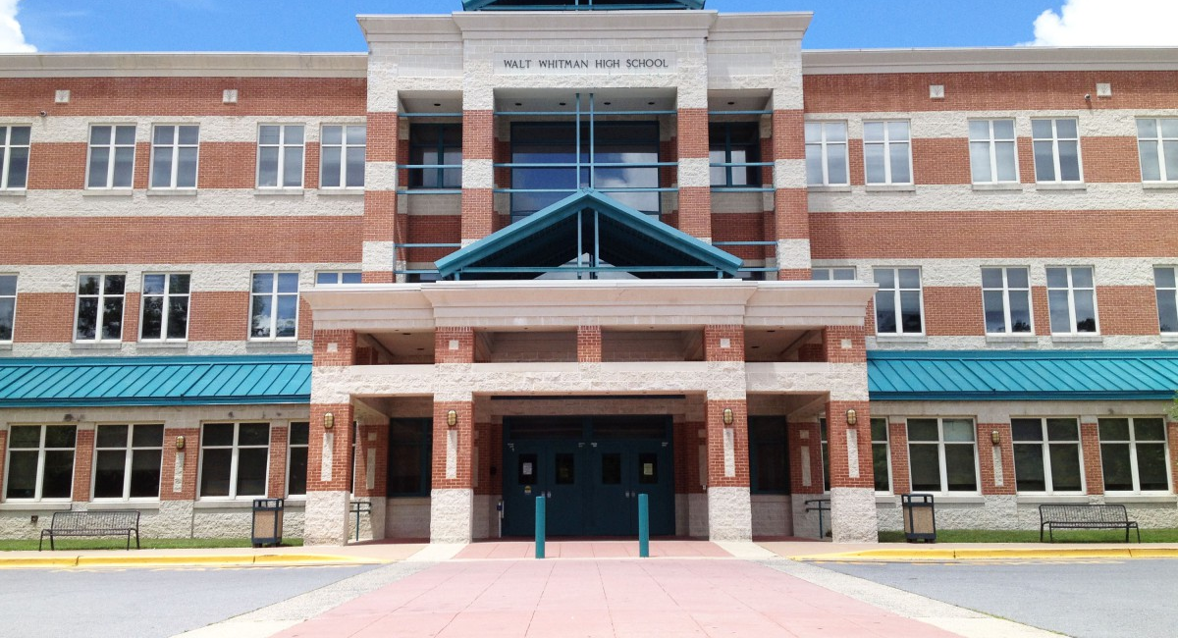
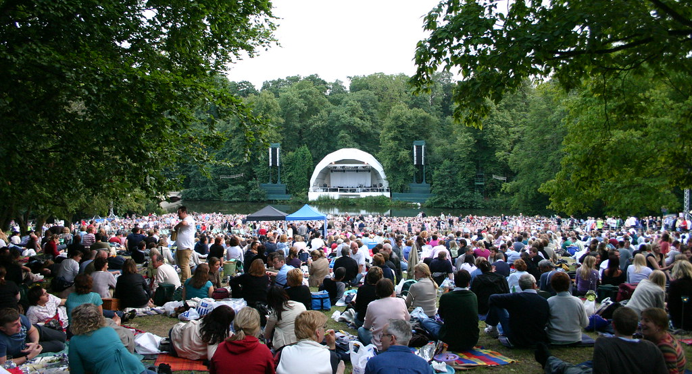
Where do most shootings happen?

Slide 12
University of Texas August 1, 1966
Notes:
A former Marine stabbed and killed his mother and his wife the night before he went to the top of the university of Texas and opened fire on people.

Slide 13
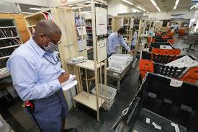
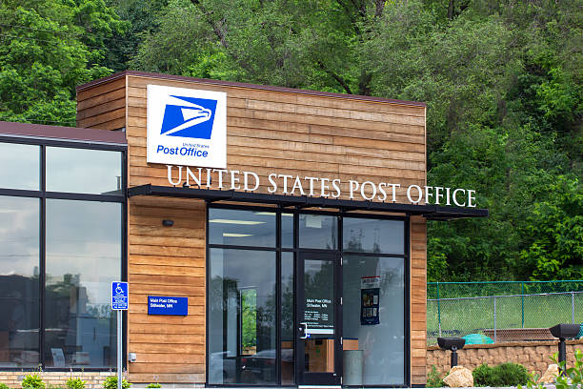
1980s
Notes:
Then we moved forward to the ‘80s where postal workers were shooting and killing each other. Ask the class, Hence… why do we say going postal?
This Photo by Unknown Author is licensed under CC BY-SA

Slide 14
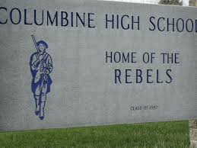
APRIL 20, 1999
Notes:
*Nation is shocked/news coverage
*Let’s call this an active shooter since they were shooting throughout the school
*Wanted to define it but not just on one event
*History……
*They knew there were more events, so they went all the way back to 1966

Slide 15
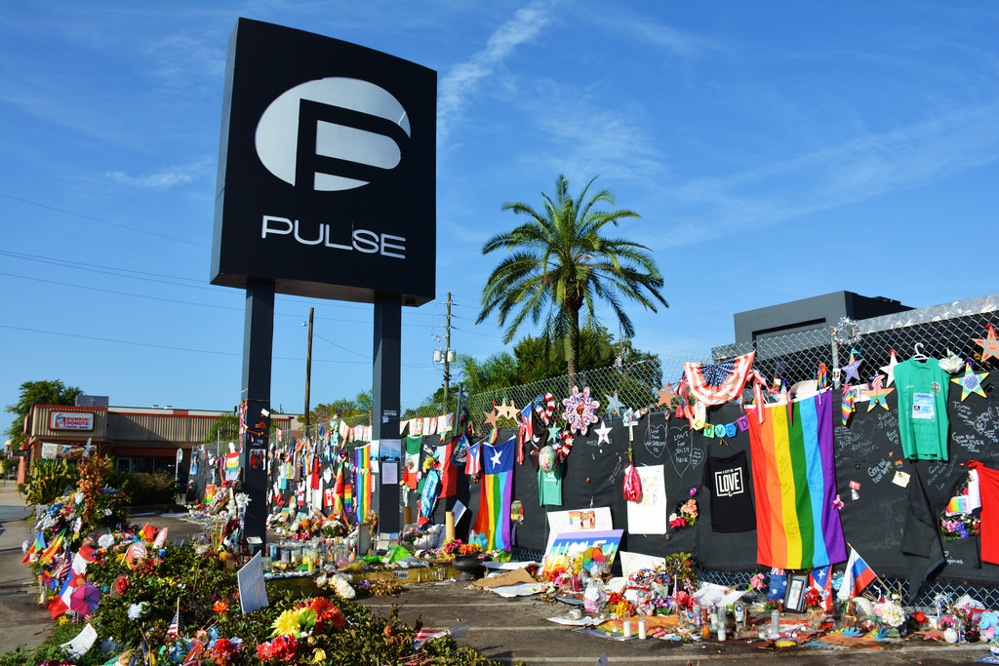
ORLANDO, FL (2016)
Notes:
Pulse nightclub attack where an Islam-inspired terrorist attacked and killed 49 people. The shooter was connected to this nightclub in that he frequented the business as a patron.

Slide 16
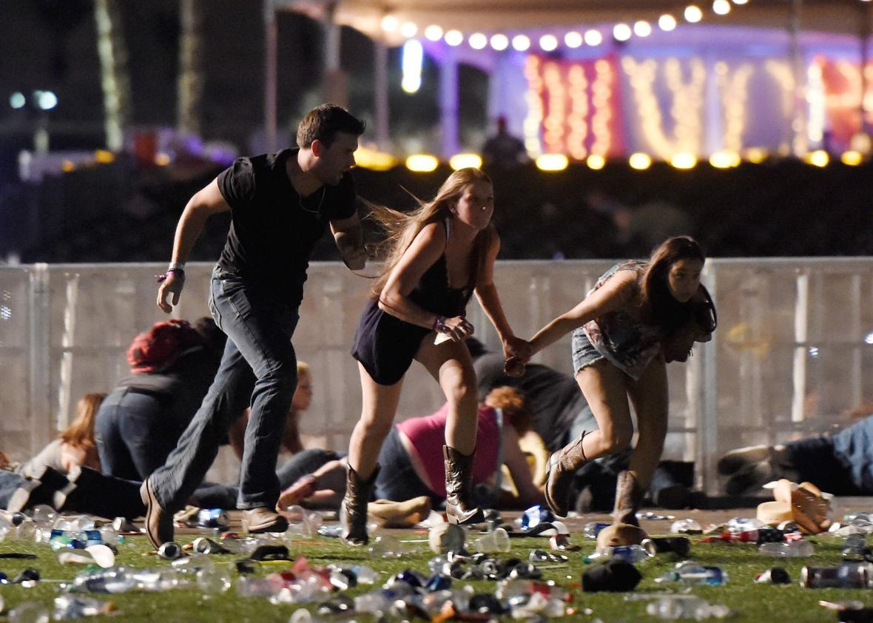
LAS VEGAS, NV (2017)
Notes:
Individual attacked concert goers from an elevated position at the Mandalay Bay Hotel killing 59 making this the highest Active Shooter mass casualty incident since 9-11 in the United States. Stress the use of Avoid, Deny & Defend. Since they were in an open-air environment can they deny bullets from hitting them by seeking hard cover. Explain hard cover to people you are lecturing.

Slide 17
2022
There have been more than 600 mass shootings so far in 2022 November 23, 2022 Washington Post
5 Killed Hedingham Neighborhood Raleigh, NC
5 Killed Club Q, Colorado Springs
3 Killed University of Virginia in Charlottesville
5 Killed Walmart in the Tidewater area of Virginia

Slide 18
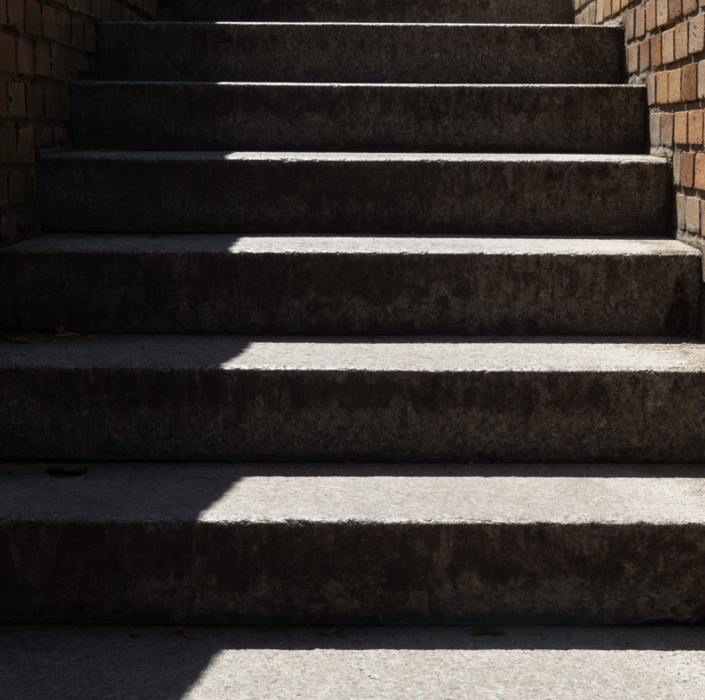
Three Stages of Disaster Response
Denial
Deliberation
Decisive Moment

Slide 19
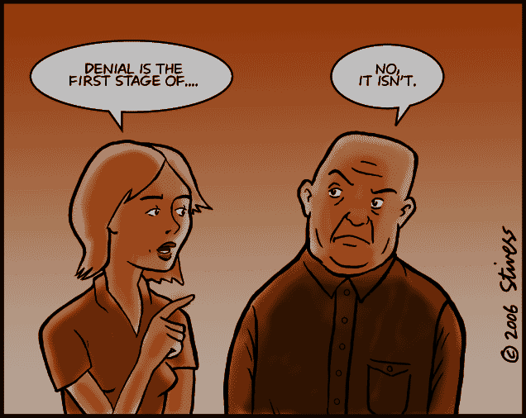
Denial
Notes:
Image credit: http://www.markstivers.com/wordpress/?p=300
Many people do not admit that there is a disaster, or they underestimate the severity of the disaster. People delay taking action and this delay costs lives.
In the World Trade Center, people called others to check with them, logged off of their computers, and packed up their things before beginning to evacuate.
So why do people do it?
Normalcy Bias – The brain is lazy. It wants things to fit into existing plans. It tries to define a disaster as something else that we are already familiar with. For example, in active shooter attacks, many people describe hearing the shots, but attribute it to fireworks. This is because the brain is more easily able to process someone shooting off fireworks than someone shooting or murdering people.
Social Proof – We are social animals. We look to each other for clues about how to behave. This is especially the case when a situation is new or ambiguous. Consider any time you might have been at a large, formal dinner party. There are many different plates, glasses, and silverware for each person. If you are unsure about which utensil to use, a very easy way to determine the appropriate response is to watch others around you to see what they are using … and then do the same. This is important because a few people doing the right things can save many.

Slide 20
Deliberation
Human Brain
Fight
Flight
Freeze
Notes:
Click to bring up Human Brain – it is
Reflective
Thinking brain
Flexible
Rational
Slow
You have to think about it
Click again - Lizard Brain
Reflexive
Reacting Brain
Fixed
Emotional
Fast
It just happens

Slide 21
What Should I do?
Deliberation:
Avoid, Deny, Defend
or
Run, Hide, Fight

Slide 22
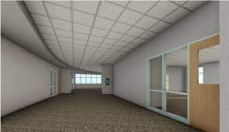
Movement and Distance
Knowing your exits :
Traditional and
Non-Traditional
Notes:
Continue talking about non-traditional exits
The ceiling is a non-traditional exit

Slide 23
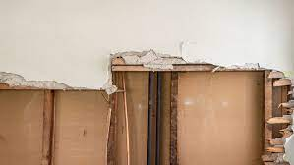
Movement and Distance
Know your exit – traditional and non-traditional exits
Notes:
Continue talking about non traditional exits

Slide 24
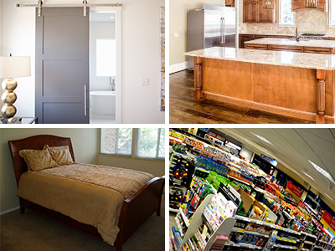
Movement and Distance
Cover
vs.
Concealment
Notes:
Ask class if I try to conceal my body behind this chair, am I any safer…

Slide 25
Decisive Moment
JUST
DO
IT
Notes:
Movement and Distance

Slide 26
Norris Hall

Slide 27
AVOID:
Be AWARE of your surroundings
Leave location ASAP
Know where your exits are…..and possible alternate exits
Call 911 once you are safely away from the location
Get out of the hallways and common areas.

Slide 28
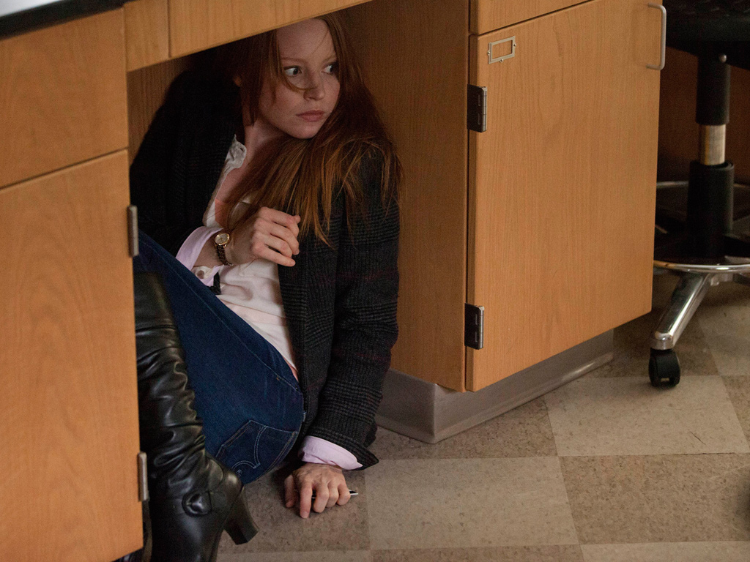
Hiding Alone Could Get You Killed
Hide & Hope

Slide 29
Playing Dead

Slide 30
Lockdown vs. Run, Hide & Fight
Lockdown (aka: Lock Out)
A process where the person(s) decide to secure and hide in place.
Effective primarily if the threat occurs outside the building.
If you cannot run, utilizing the Lockdown/Hide may be your best option.

Slide 32
Deny:
Barricade
Heavier = Better
More = Better
Doorstops = Better?
Notes:
Image: http://wfae.org/post/should-teachers-train-fight-shooters
Inward opening doors are much easier to barricade than outward opening doors. It helps to notice and keep mind of that when you enter any public building.

Slide 33
Deny:
Outward opening
Ropes
Tactical Cinch
Notes:
Image: Texas State University – Advanced Law Enforcement Rapid Response Training Center
These are some alternatives to barricading for outward opening doors. Using desks and chairs is still a valid alternative. Even if the shooter opens the door, he will still have to remove the obstacles to enter. This will provide you with a little bit of time and can create a vulnerable moment for the shooter to be open to attack.

Slide 34
What you do, Matters!
Never
Give
Up

Slide 35
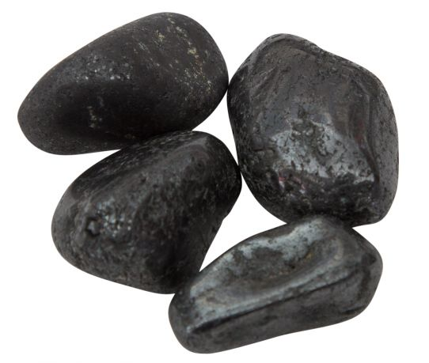
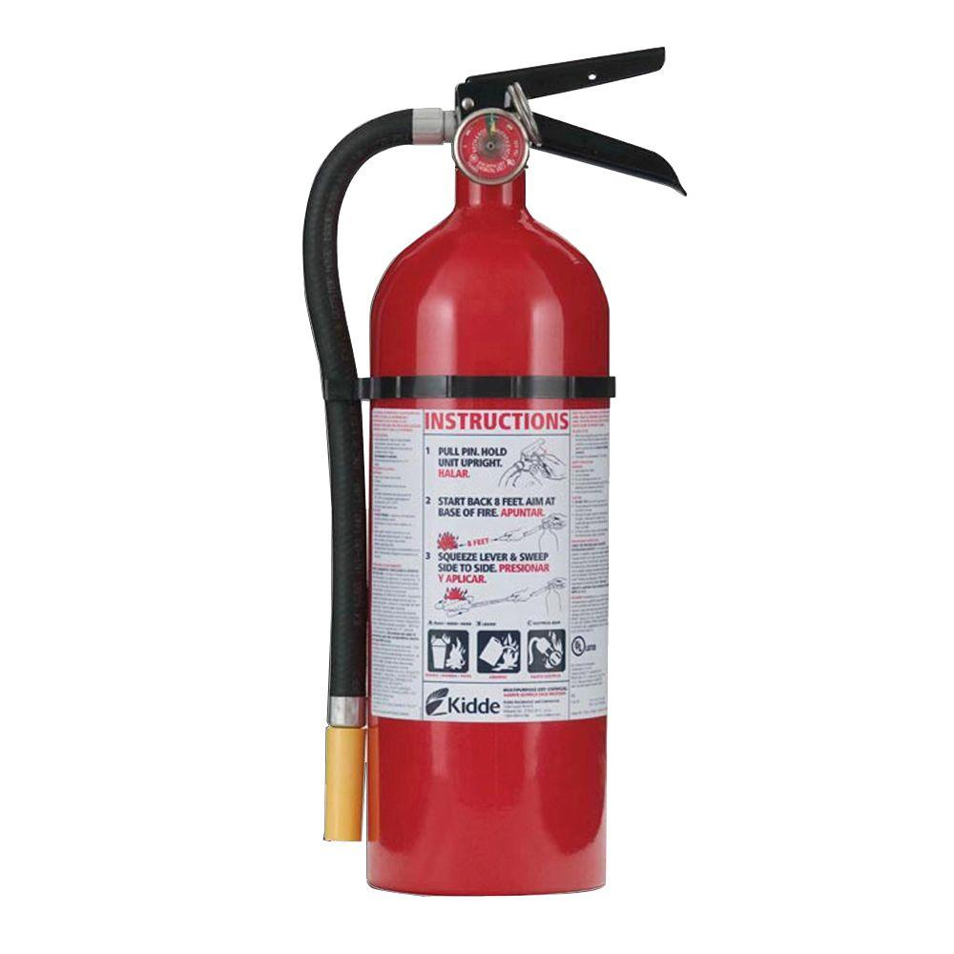
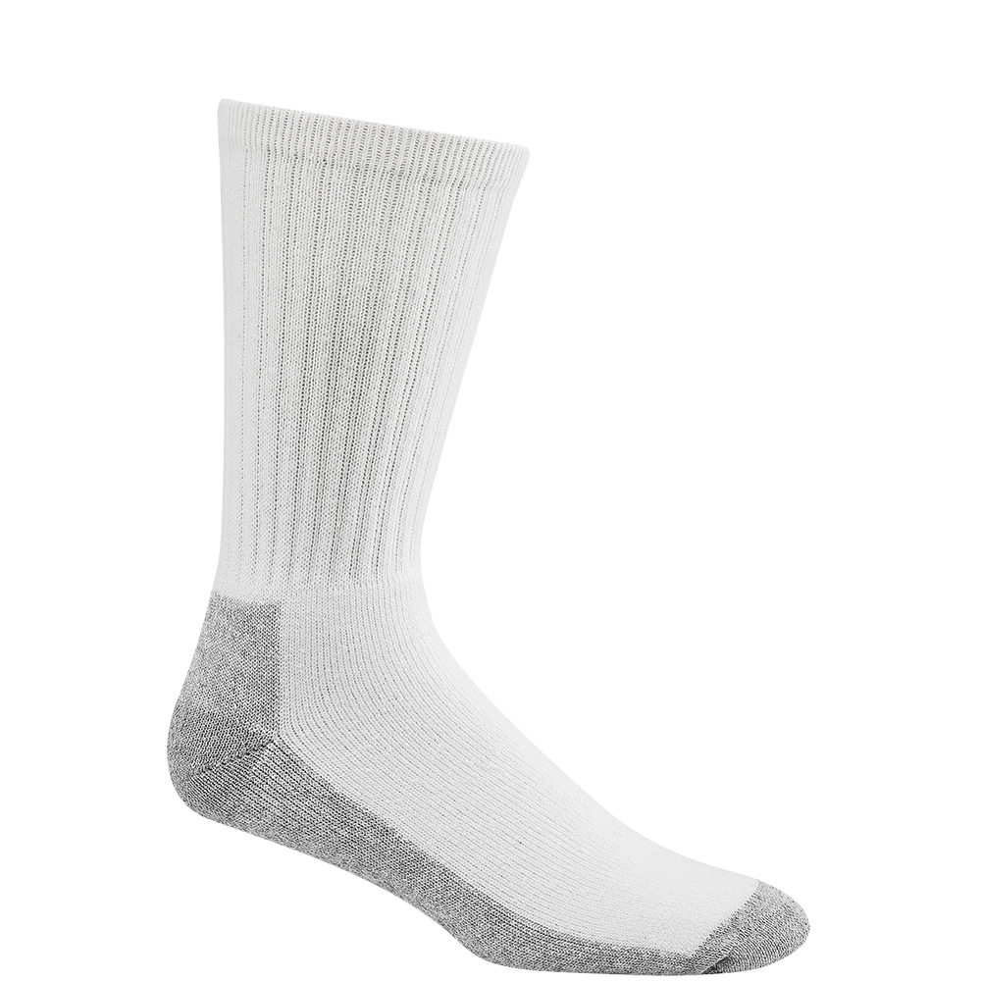
Tools of opportunity

Slide 36
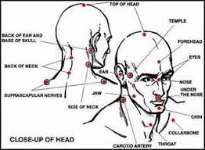
Attack Points on Human Head

Slide 37
Defend / Fight
Notes:
This gentlemen looks for alternatives by grabbing what appears to be a bottle of wine in preparation to defend himself he later determines that avoidance is the better option and runs down an aisle and escapes out the back of the store. In contrast, watch the lady in the blue shirt. As we saw earlier with Kristina Anderson, using the “playing dead” approach is a flawed tactic.
THIS IS A VIDEO

Slide 38
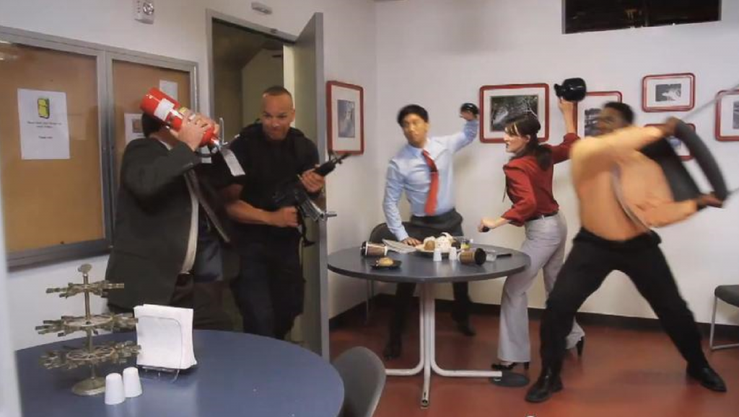
Defend:
Positioning
Grab the gun
Fight
Notes:
Image: http://www.academy-kravmaga.co.uk/blog/
Stand near the door – Not across the room. If you are close, you have a chance to fight. If you are far, you can get shot.
Get ahold of the gun, don’t let go and point it away from people.
Fight for your life. This is not a fair fight. Use improvised weapons, gouge eyes, bite, kick, pull hair.

Slide 39
U.N.C. Charlotte Student Couldn’t Run, So He Tackled the Gunman
“The police said Riley C. Howell, 21, saved the lives of others as he sacrificed his own by confronting a gunman who opened fire in a classroom at the University of North Carolina”
“Run, Hide, Fight. Secure yourself immediately.”

Slide 40
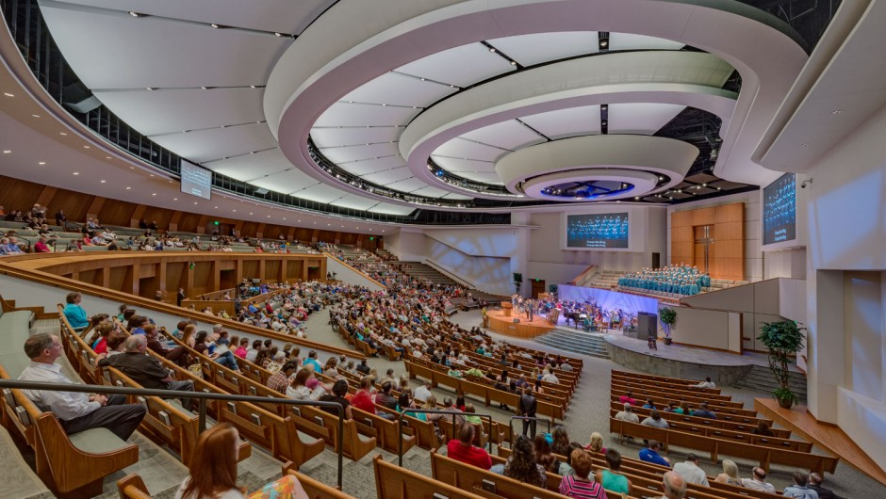
CHURCH Auditorium

Slide 41
CHURCH Auditorium
Very Difficult to Deny - Avoid & Defend become best options
Defend Considerations –
Parking Lot monitors/security
Parishioners dedicated to protection seated next to entrances into sanctuary or roving lobby.

Slide 42
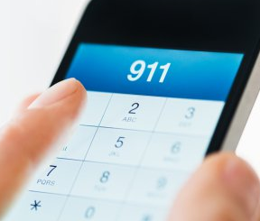
Provide Information - 911
If safe to do so, provide 911 operators and Law Enforcement (LEN) Officers with:
Location of shooter
Number of shooters
Physical description of shooters
Number and types of weapons
Number of potential victims
Follow dispatcher’s or police instructions
Notes:
If on a phone or if law enforcement has arrived and if you have met them on the scene, they’ll need vital information you can provide.
Photo: freetext.com

Slide 43
Police Arrival Time
3 Minutes –City
8-10 Minutes - Rural
Notes:
Average response time for US law enforcement.

Slide 44
When Police Arrive
Officers do not know you !
Follow police instructions at all times!!!
Be prepared for:
Weapons pointed / Searches / Handcuffed
LE Priority:
Stop Killing / Stop the Dying / Evacuate the Area

Slide 45
When Police Arrive…
DO NOT
Have anything in your hands / Make sudden moves or rush officers
DO
Raise your arms and spread your fingers / Follow commands
Understand
Area will be treated as a crime scene
NO re-enter the building
Moved to a holding area for Medical treatment / Interviewing / Counseling

Slide 46
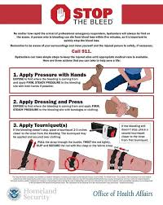
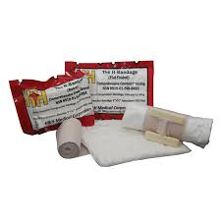
Survival
Pressure Dressing
Stop all blood flow ~ Can bleed to death in 4-7 minutes Tourniquet
(Improvised vs. Official)

Slide 47
Final Thoughts
Have a source of info available to first responders.
Floor plans Access cards/master keys
Evacuation routes Point of contact info
Have a plan & and practice
Avoid, Deny, Defend / Run, Hide, Fight
“SEE SOMETHING SAY SOMETHING!”

Slide 49
Questions?

Slide 50
Contact Information
Brother Tito Koonce
Sixth District
Conflict Resolution Chairman
704-957-5707
titoq@hotmail.com
Brother Steven Durant
Police Lieutenant – Retired
Pi Phi Chapter - KRS
704-980-9338
masque730@gmail.com

